Slide 1

RaspberryPi

Slide 2
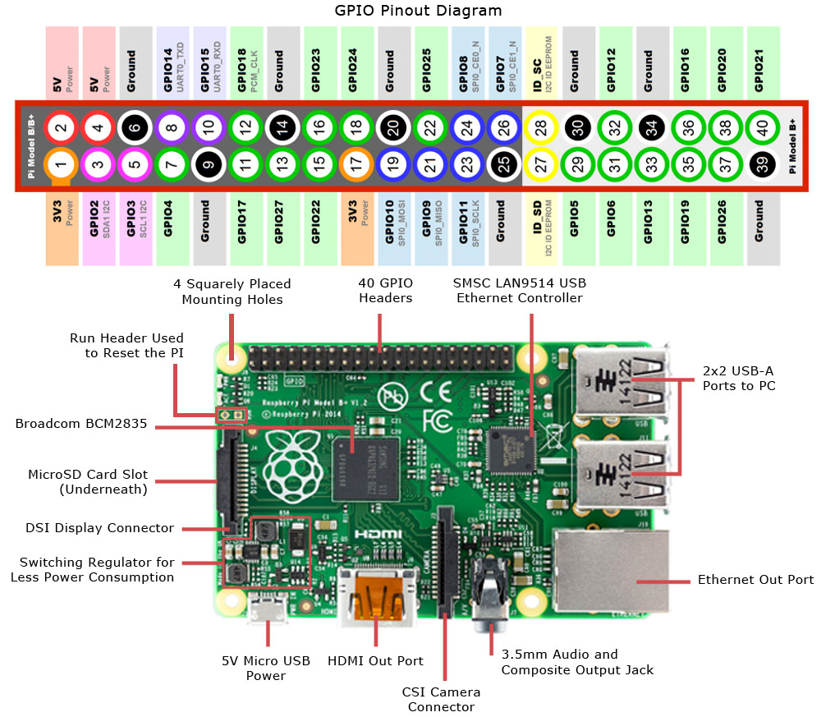

Slide 3
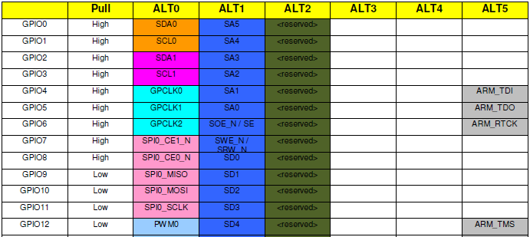

Slide 4
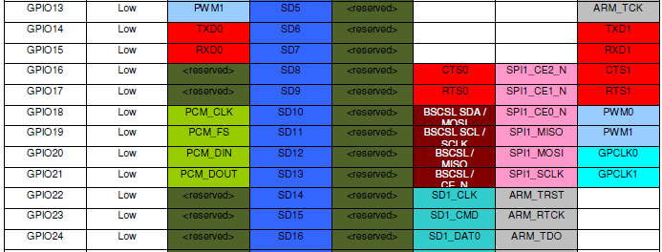

Slide 5
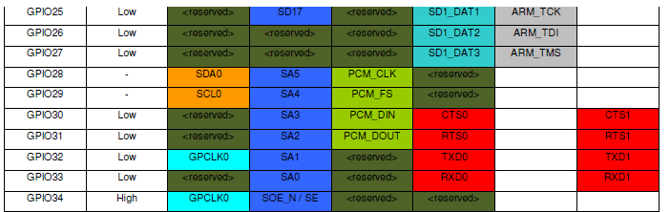

Slide 6
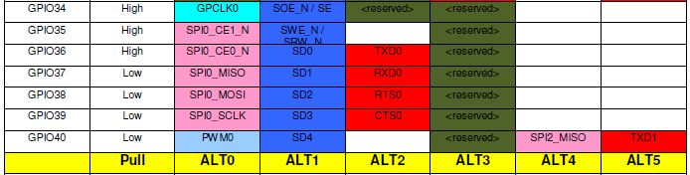

Slide 7
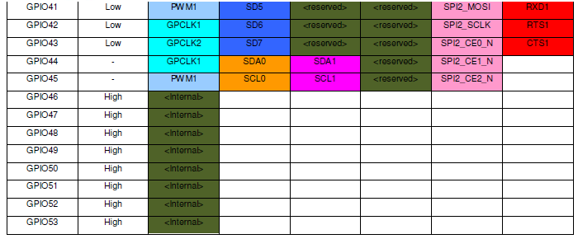

Slide 8
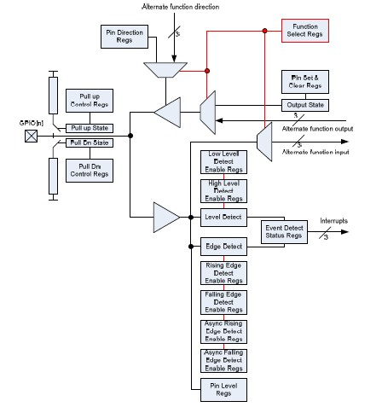

Slide 9
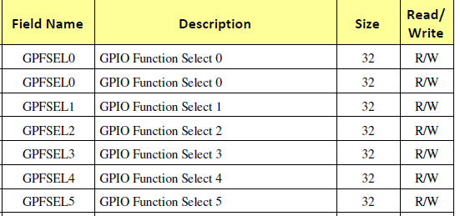
Selecting pin with respective registers

Slide 10
GPIO Function Select Registers (GPFSELn)
The function select registers are used to define the operation of the general-purpose I/O pins.
Each of the 54 GPIO pins has at least two alternative functions.
The FSEL{n} field determines the functionality of the nth GPIO pin.
All unused alternative function lines are tied to ground and will output a “0” if selected.
All pins reset to normal GPIO input operation.

Slide 11
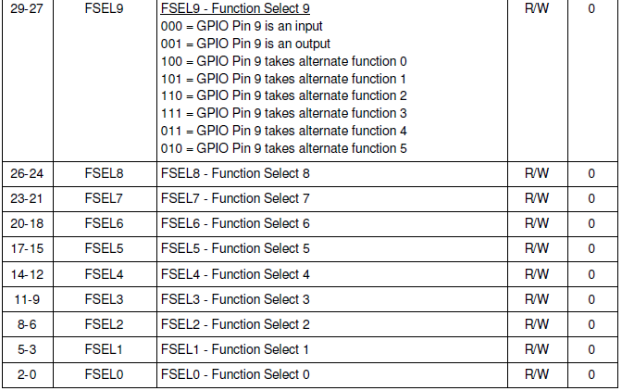
GPFSEL0

Slide 12
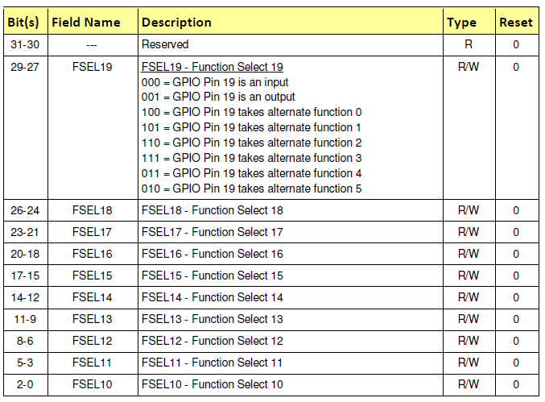
GPFSEL1

Slide 13
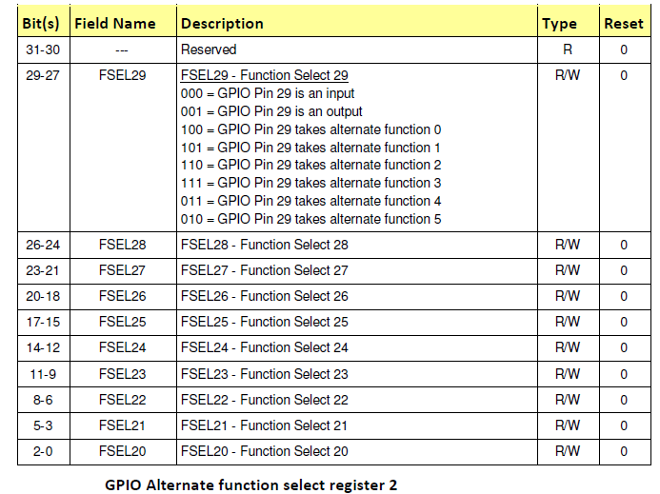

Slide 14
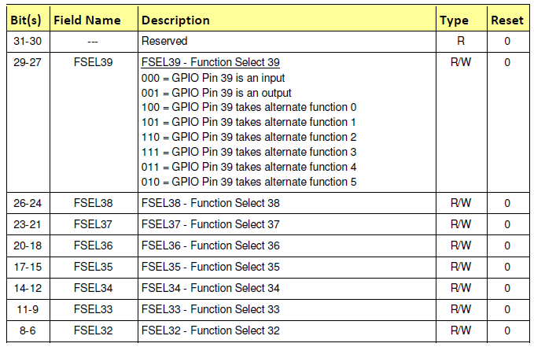


Slide 15
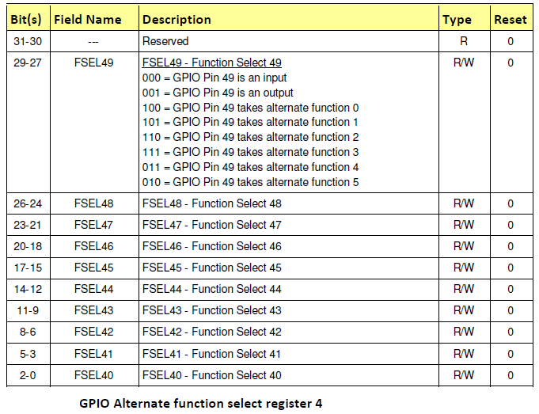

Slide 16
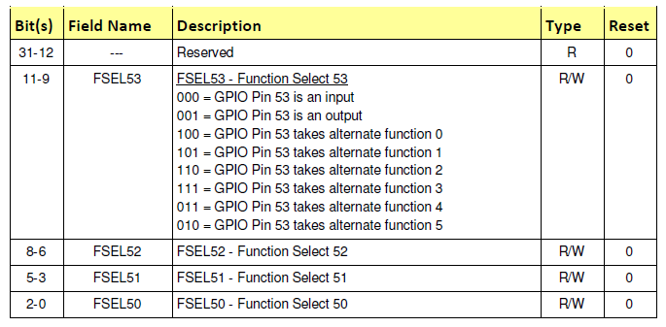
GPIO Alternate function select register 5

Slide 17
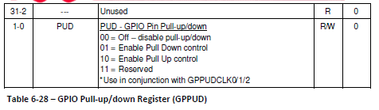
GPIO Pull-up/down Register (GPPUD)

Slide 18
GPIO Pin Output Set Registers (GPSETn)
The output set registers are used to set a GPIO pin. The SET{n} field defines the respective GPIO pin to set, writing a “0” to the field has no effect. If the GPIO pin is being used as in input (by default) then the value in the SET{n} field is ignored.
However, if the pin is subsequently defined as an output then the bit will be set according to the last set/clear operation.
Separating the set and clear functions removes the need for read-modify-write operations

Slide 19
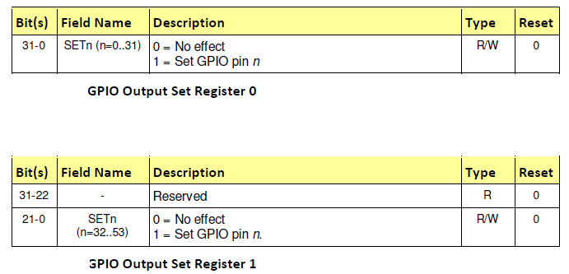
GPIO Pin Output Set Registers (GPSETn)

Slide 20
GPIO Pin Output Clear Registers (GPCLRn)
The output clear registers are used to clear a GPIO pin. The CLR{n} field defines the respective GPIO pin to clear, writing a “0” to the field has no effect.
If the GPIO pin is being used as in input (by default) then the value in the CLR{n} field is ignored.
However, if the pin is subsequently defined as an output then the bit will be set according to the last set/clear operation.
Separating the set and clear functions removes the need for read-modify-write operations.

Slide 21
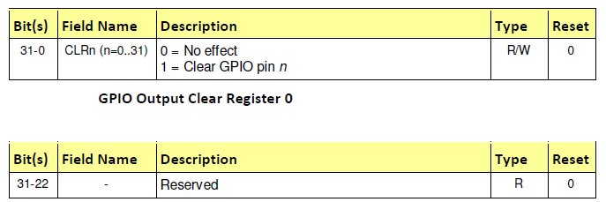
(GPCLRn)

Slide 22
GPIO Pin Level Registers (GPLEVn)
The pin level registers return the actual value of the pin. The LEV{n} field gives the value of the respective GPIO pin.

Slide 23
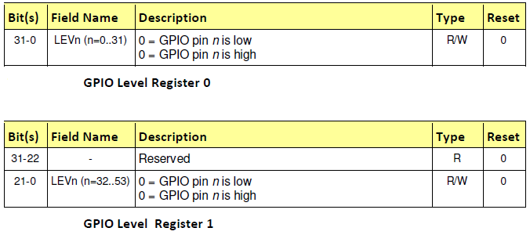
(GPLEVn)

Slide 24
GPIO Event Detect Status Registers (GPEDSn)
The event detect status registers are used to record level and edge events on the
GPIO pins.
The relevant bit in the event detect status registers is set whenever:
1) An edge is detected that matches the type of edge programmed in the rising/falling edge detect enable registers, or
2) a level is detected that matches the type of level programmed in the high/low level detect enable registers.
The bit is cleared by writing a “1” to the relevant bit.
The interrupt controller can be programmed to interrupt the processor when any of the status bits are set. The GPIO peripheral has three dedicated interrupt lines.
Each GPIO bank can generate an independent interrupt. The third line generates a single interrupt whenever any bit is set

Slide 25
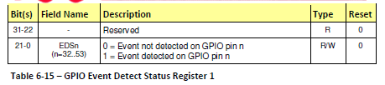


Slide 26
GPIO Rising Edge Detect Enable Registers (GPRENn)
GPIO Falling Edge Detect Enable Registers (GPRENn)
GPIO High Detect Enable Registers (GPHENn)
GPIO Low Detect Enable Registers (GPLENn)
GPIO Asynchronous rising Edge Detect Enable Registers (GPARENn)
GPIO Asynchronous Falling Edge Detect Enable Registers (GPAFENn)

Slide 27
REG CONFIGURATION
GPFSELn = 0X
GPPUDn = 0x
GPSETn = 0x
GPCLRn = 0x

Slide 28


